Slide 2
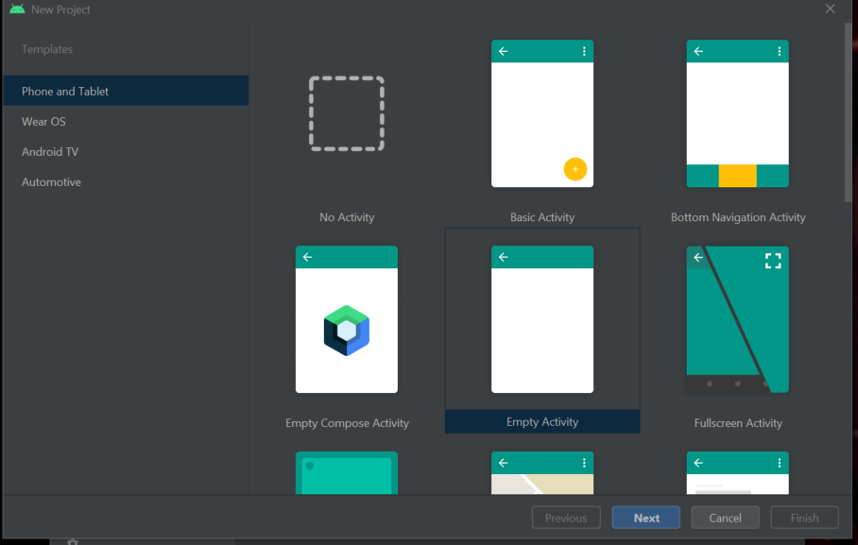
Click “New project”-> “Empty Activity”

